Slide 1
Test for
Lack of Fit
We use a lack of fit test to determine whether a specific type of regression function adequately fits the data.
The test assumes that the observations Y for a given X are independent and normally distributed and that the distributions of Y all have the same variance.
The test also requires that there are repeat observations at one or more X levels.
Repeat trials of the same level of a predictor variable are called replications and the observations are called replicates.

Slide 2
Test for
Lack of Fit
We consider an example involving money market accounts at a bank.
Holders of checking accounts were offered gifts for opening up money market accounts and minimum deposits were required to qualify for the gifts.
The value of the gift was directly proportional to the amount required for the minimum deposit.
Various levels of minimum deposits and related gift values (X) were used to determine the relationship between them and the number of accounts opened (Y)

Slide 3

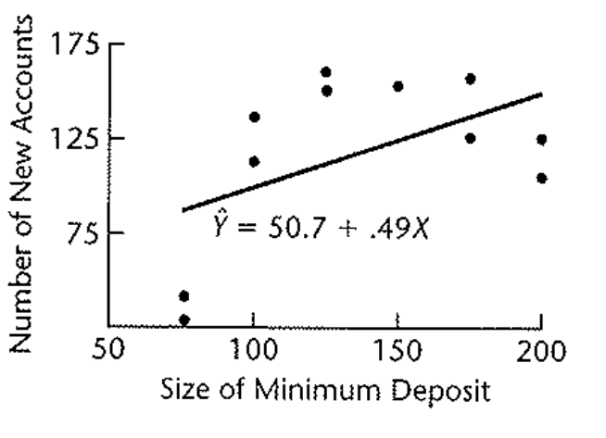
Test for
Lack of Fit
A linear regression was fit to the data which produced
Looking at a scatter plot with the fitted regression line, however, indications are that a linear model is not appropriate for this data.

Slide 4
Test for
Lack of Fit
To test formally whether a linear model is appropriate, we will use the general linear test approach.
Since we have multiple replications at each level of X, we will modify the notation. We will denote the different X levels in the study as X₁, X₂,… X_{c}.
In the bank example there are 6 deposit levels, so c=6. For example X₁ is 100, the smallest minimum deposit.
We denote the number of replicates for the jth level of X as n_{j} and the total number of observations is the sum of all the n_{j}.

Slide 5
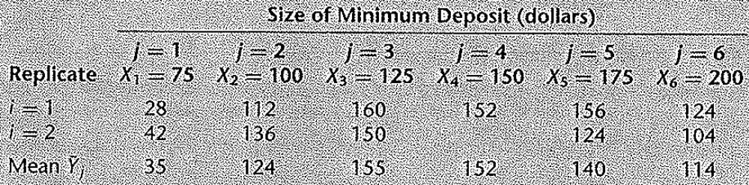
Test for
Lack of Fit
We denote the observed value of the response variable for the ith replicate and the jth level of X by Y_{ij}, i=1,…,n_{j} , j=1,…,c.
For the bank example, what is Y₂₁?

Slide 6

Test for
Lack of Fit
We denote the mean of the Y observations at the level X=X_{j} by Y_{j}(bar). For example Y₁(bar) = (28+42)/2 = 35.
The general linear test approach begins with the specification of the full model.
The full model used for the lack of fit test makes the same assumptions as the simple linear regression model except for assuming a linear relationship, which is what we are testing.
The full model is
where μ_{j} are parameters and ε_{ij} are N(0,σ²)

Slide 7


Test for
Lack of Fit
Since the expected value of the error terms is 0, we have that
Thus the parameter μ_{j} is the mean response when X=X_{j} and each response Y is made up of two parts the mean response when X=X_{j} and a random error term
Our earlier regression model, using the current notation, is

Slide 8
Test for
Lack of Fit
And for our earlier regression model, we have that
The difference between the full model and the linear regression model we studied earlier is that in the full model there are no restrictions on the means while in the previous regression model, the mean responses are linearly related to X.
To fit the full model to the data, we require the least squares or maximum likelihood estimators for the parameters μ_{j}.

Slide 9

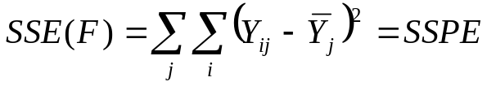
Test for
Lack of Fit
It can be shown that these estimators of μ_{j} are the sample means Y_{j}(bar).
Therefore, the estimated expected value of Y_{ij} is Y_{j}(bar) and the error sum of squares for the full model is
The full model error sum of squares is called the pure error sum of squares and is denoted by SSPE.

Slide 10


Test for
Lack of Fit
Note the SSPE is made up of sums of squared deviations at each X level. At X=X_{j}, this sum of squared deviations is
These sums of squares are then added over all the X levels.
Note that any X level with only one replication makes no contribution to SSPE because then

Slide 11
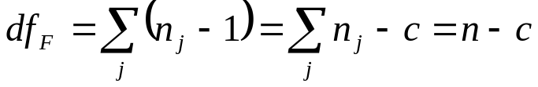
Test for
Lack of Fit
The degrees of freedom associated with SSPE can be obtained by recognizing that the sum of squared deviations at a given level of X is like an ordinary total sum of squares based on n observations, which has n-1 df associated with it.
Here, there are n_{j} observations when X=X_{j} thus the degrees of freedom are n_{j} – 1.
Just as SSPE is the sum of the sum of squares, the degrees of freedom are the sum of the degrees of freedom associated with each value of X_{j}

Slide 12
Test for
Lack of Fit
For the bank example, there are 11 total observations and 6 deposit levels, levels of X, so the degrees of freedom are 11-6=5.
Note that any X level with only one replication makes no contribution to the degrees of freedom since n_{j} – 1 = 1-1 = 0.
To test the appropriateness of a linear relation, we will use the hypotheses
Thus, the null states that μ_{j} in the full model is linearly related to X_{j}.

Slide 13


Test for
Lack of Fit
To proceed with the general linear test approach, we need a reduced model. The reduced model will correspond with the null hypothesis which is our earlier regression model.
The reduced model under H_{o} is
We know that the estimated expected value for observation Y_{ij} is the fitted value

Slide 14
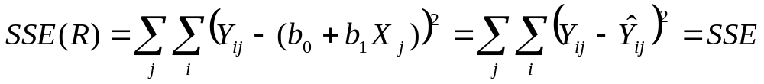
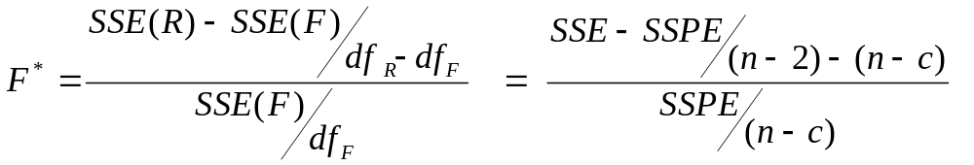
Test for
Lack of Fit
The error sum of squares for the reduced model is the usual error sum of squares SSE
We have that the degrees of freedom associated with SSE(R) are df_{R} = n-2.
The general linear test statistic becomes

Slide 15
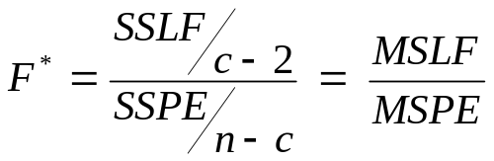
Test for
Lack of Fit
The difference between the two error sums of squares is called the lack of fit sums of squares and is denoted by SSLF:
SSLF = SSE – SSPE
We can then express the test statistic as
where MSLF is the lack of fit mean square and MSPE is the pure error mean square.

Slide 16
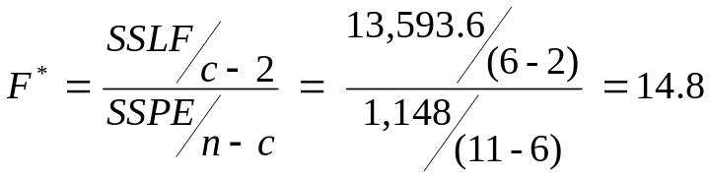
Test for
Lack of Fit
We reject the null for large values of the test statistic and our decision rule is
If F* ≤ F(1-α;c-2,n-c), fail to reject Ho
If F* > F(1-α;c-2,n-c), reject Ho
For the bank example, we have that SSPE = 1,148 and SSE = 14,741.6 therefore SSLF = 14,741.6 – 1148 = 13,593.6.
Thus we have
For α = .01, F(.99:4,5) = 11.4

Slide 17
Test for
Lack of Fit
Since F* = 14.8 > 11.4 we reject the null that the regression function is linear. This matches our visual impression from the scatter plot.
The p-value for the test is .006.
Note, if we failed to reject the null, we would conclude that we had sufficient evidence to use a linear model, even though we don’t “accept” the null.
We decomposed the error sum of squares into two components
SSE = SSPE + SSLF

Slide 18

Test for
Lack of Fit
This decomposition follows from the identity:
This identity shows that the error deviations in SSE are made up of a pure error component and a lack of fit component.
The mean of the 3rd deposit level is Y₃(bar) = 150, observation Y₁₃ = 160 and for X₃ = 125, we have
Error Deviation
Pure error deviation
Lack of fit deviation

Slide 19
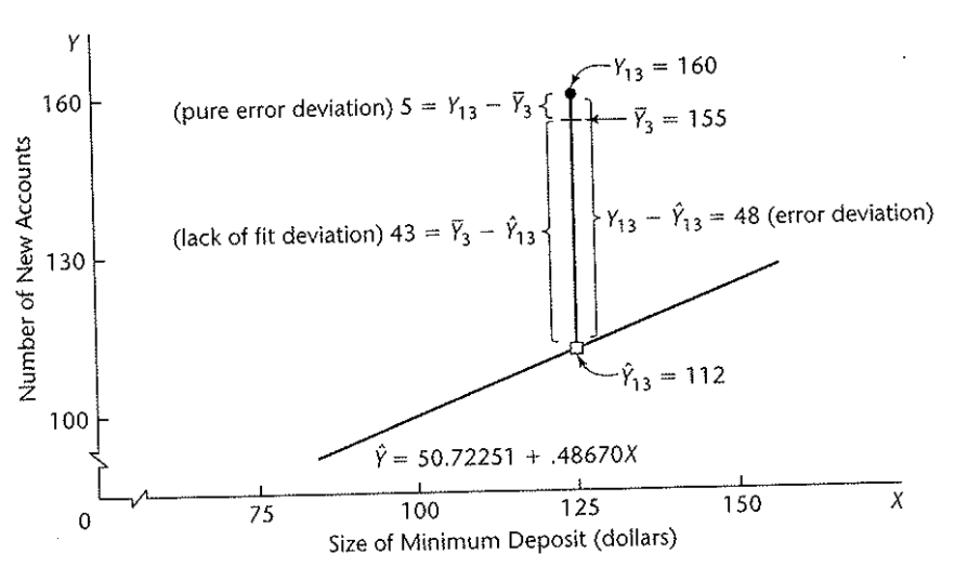
Test for
Lack of Fit
Therefore we have

Slide 20
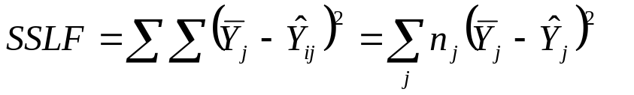
Test for
Lack of Fit
When the decomposition of the error deviation is summed and squared over all observations, we maintain our equality.
SSE = SSPE + SSLF
From this we can define the lack of fit sum of squares directly as
since all the observations at the jth level of X have the same fitted value denoted by Y_{j}(hat).

Slide 21
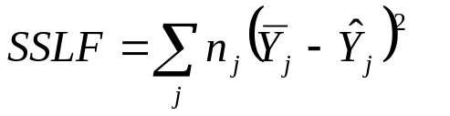
Test for
Lack of Fit
If the linear function is appropriate, then the means Y_{j}(bar) will be near the fitted values Y_{j}(hat) calculated from the regression function and SSLF will be small.
On the other hand, if the linear regression function is not appropriate, the means Y_{j}(bar) will not be near the fitted values Y_{j}(hat) calculated from the regression function and SSLF will be large.
This is why SSLF measures lack of fit.

Slide 22
Test for
Lack of Fit
There are c means Y_{j}(bar) in the sum of squares, and two degrees of freedom are lost in estimating the parameters β₀ and β₁.
Thus we have c-2 degrees of freedom associated with SSLF.
As shown by the bank example, not all levels of X need to have repeat observations for the F test for lack of fit to be applicable.
Repeat observations at only one or some levels of X are sufficient.

Slide 23
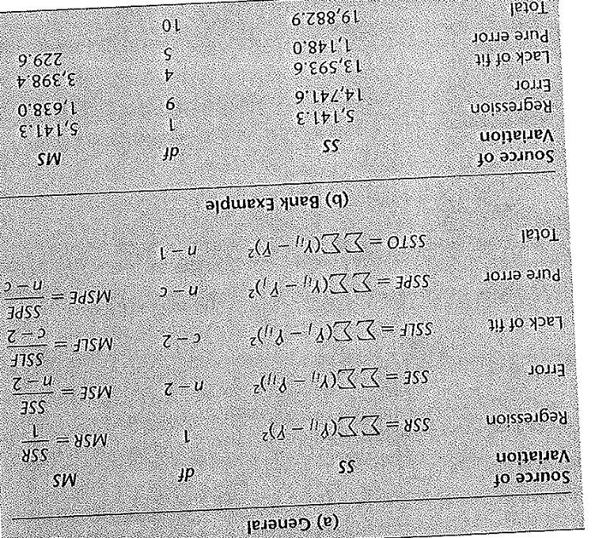
Test for
Lack of Fit
An ANOVA table can be constructed for the decomposition of SSE. This table contains the general ANOVA table, including the decomposition of SSE and the mean squares.

Slide 24
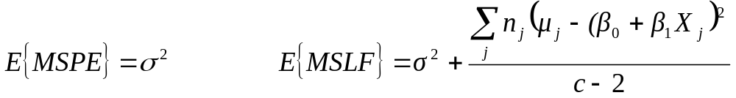

Test for
Lack of Fit
We have that
The reason for the term “pure error” is that MSPE is always an unbiased estimator of the error term variance σ², no matter what the true regression function is.
The expected value of MSLF is also σ² if the linear function is linear, since then
and the second term becomes 0.

Slide 25
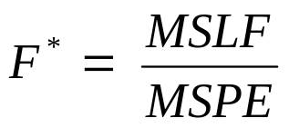
Test for
Lack of Fit
On the other hand, if the regression function is not linear, then E{MSLF} will be greater than σ² and hence E{MSLF} > E{MSPE}
Since we have
a value of F* near 1 is in agreement with the null that the function is linear (both have expected values σ² when the function is linear).
When the regression function is not linear E{MSLF} > E{MSPE} and large values of F* indicate the regression function is not linear.

Slide 26
Test for
Lack of Fit
The terminology “error sum of squares” and “error mean squares” is not precise when the regression function under test in the null is not the true function.
Then the error sum of squares and error mean square reflect the effects of both the lack of fit and the variability of the error terms.
The terms are still used for consistency but we now use the term “pure error” to identify the variability associated with the error term only.
It is important to examine the appropriateness of a model before drawing any conclusions.

Slide 27
Test for
Lack of Fit
If we use a linear regression function to test the effects of minimum deposit size (and value of gift) on the number of new accounts, we would conclude there is no relation between the two.
This conclusion is improper since such an inference requires the model be appropriate. Here there is definitely a relationship, it is just not a linear relationship.
The general linear test approach can be used to test the appropriateness of other regression functions.
Only the degrees of freedom for SSLF will need to be modified. In general, c-p df are associated with SSLF, where p is the number of parameters in the regression function.

Slide 28

Test for
Lack of Fit
The alternative hypothesis in our test,
includes all regression functions other than a linear one. For instance, it includes a quadratic regression function or a logarithmic function.
If the null is rejected, a study of the residuals can be helpful in determining an appropriate function.
If we decide that the reduced model in H_{o} is appropriate, we use the MSE as an estimator of σ² instead of the pure error mean square MSPE since the MSE has more df.

Slide 29
Test for
Lack of Fit
The repeat observations need to be independent trials. Generally this means trials on different subjects.
For instance, if we are studying the effects of height on weight and we want multiple measurements of somebody 6 feet tall, we can’t just find one person 6 feet and measure his weight 5 times.
If we want to know the effects that the amount of fertilizer has on trees, we can’t take 5 leaves from the same tree and treat them as 5 replicates.
We would need to get a leaf from 5 different trees with the same level of fertilizer.

